Slide 1
Python : Sequences

Slide 2
Content
Stack with lists
List comprehension
Expressions
Sequence processing function
Two-dimensional lists

Slide 3
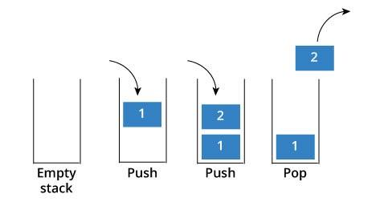
Stack
A linear data structure
Order LIFO(last in first out) or FIFO(first in last out)-see below fig-

Slide 4
Create stack using list
Create a list using [ ] or list()
In [1] : stack = [ ]

Slide 5
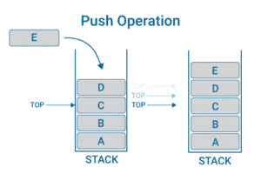
Push into stack
Add a value using .append() method
Push from one by one
In [1] : stack = [ ]
In [2] : stack.append(‘A’)
In [3] : stack.append(‘B’)
In[4] : stack.append('C')
In[5] : stack.append('D')
In[6] : stack.append('E')

Slide 6
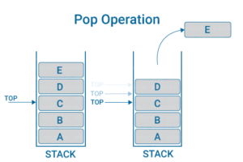
Pop from stack
Remove a value using .pop() method
Pop works from top element
In [1] : stack
Out [1] : [' A', 'B', 'C', 'D', 'E']
In [2] : stack.pop() #pop inside takes no parameter
Out [2] : ‘E’

Slide 7
List comprehensions
An elegant way to define and create lists based on existing lists
Generally more compact and faster than normal functions and loops for creating list.
In [4] : list2 = [ item for item in range(1, 6) ]
Out [4] : [ 1, 2, 3, 4, 5 ]
# “for item in range(1, 6)” iterates over the sequence produced by range(1, 6).

Slide 8
Generator Expressions
A generator is a function that produces a sequence of results instead of a single value
Examples shows that it print out the numbers that are odd.
In [1] : numbers = [10, 3, 7, 1, 9, 4, 2, 8, 5, 6]
In [2] : for value in (x for x in numbers if x % 2 != 0):
print(value, end=' ')
Out [2] : 3, 7 , 1 , 9, 5

Slide 9
Sequence processing function
Finding the Minimum and Maximum Values
ord( ) function used for checking the numerical values
In [1] : “Red” < “orange”
Out [1] : True #why ? numerical values
In [2] : ord('R')
Out [2] : 82
In [3] : ord('o')
Out[3] : 111
# R numerical value is less than o . that's why True

Slide 10
Reversed a sequence
reversed( ) returns an iterator that enables you to iterate over a sequence’s values backward.
In [8] use a list comprehension creates a new list containing the reverse numbers’
In [7]: numbers = [10, 3, 7, 1, 9, 4, 2, 8, 5, 6]
In [8]: reversed_numbers = [ item for item in reversed(numbers) ]
In [9]: reversed_numbers
Out[8]: [ 6, 5,8 ,2,4 ,1, 7, 3 ,10 ]

Slide 11
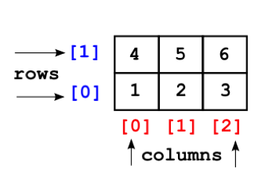
Two-dimensional lists
2D lists can contains another list as its’ elements
It’s representation in like a table
Contains two indices i.e- row and column where row specifies as first indices and second indices as column

Slide 12
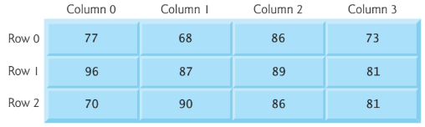
Create 2D list
Create a 2D list contains 3 students grades
Inside a list a add another 3 lists(nested) of students grade
Representations of this shown in fig
In [1] : a = [ [77, 68, 86, 73], # first student's grades
[96, 87, 89, 81], # second student's grades
[70, 90, 86, 81] ] # third student's grades

Slide 13
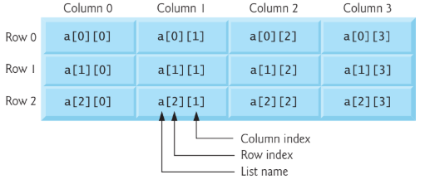
Identify an Item
Element can be identified by a name of the form a[i][j]—a is the list’s name, and i and j are the indices that uniquely identify each element’s row and column, respectively.
So, a[0][0] is 77 .

Slide 14
Iterate 2D list
2d List contains rows, columns
Accessing all elements used 2 for loops as follows
Nested for print out the rows elements
In [2] : for row in a:
for item in row:
print(item, end=' ')
print()
Out [2] : 77 68 86 73
96 87 89 81
70 90 86 81

Slide 15
Thank you all !

